Slide 1
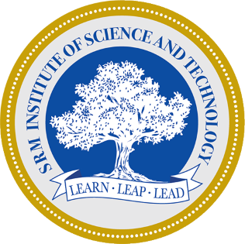
FIRST REVIEW Enhanced Diagnosis of Alzheimer's Disease through Predictive Progression Analysis of Neuro Imaging Sequences Project Category: RESEARCH
Guide Name Student Name & Registration Number
Dr. M. Karpagam V.R.Rishendra (RA2111026010221)
Rangineni Yukthamukhi (RA2111026010262)

Slide 2
Abstract
Alzheimer's disease (AD) is a progressive neurodegenerative disorder, often diagnosed too late for effective intervention with current techniques.​
This study proposes a deep learning framework combining Convolutional Neural Networks (CNNs) and Long Short-Term Memory (LSTM) networks for enhanced early AD diagnosis.​
CNNs extract spatial features from MRI neuroimaging data, identifying structural abnormalities linked to AD progression.​
LSTMs capture temporal patterns from sequential MRI scans, analyzing the progression of neurodegenerative changes over time.​
The hybrid CNN-LSTM model provides a comprehensive approach, improving diagnostic accuracy and enabling earlier detection of AD.​
This work aims to contribute to AI-driven AD diagnosis, leading to better prediction, personalized treatment, and improved patient outcomes.​

Slide 3
Introduction
Alzheimer's disease causes memory loss and cognitive decline, with early diagnosis crucial for slowing progression and improving quality of life.​
Current diagnostic methods often detect the disease only at moderate or advanced stages, limiting their effectiveness.​
AI, particularly deep learning models like CNNs, shows promise in improving the accuracy and timeliness of Alzheimer’s diagnosis.​
CNNs extract spatial features from MRI scans, while LSTMs capture temporal patterns of disease progression.​
The hybrid CNN-LSTM model combines spatial and temporal analysis to improve the accuracy of early diagnosis.​
This approach reduces false positives/negatives and can lead to AI-driven screening tools for better intervention and outcomes.​

Slide 4
Problem Statement
Alzheimer's Disease (AD) is a neurodegenerative disorder that causes cognitive decline and memory loss, impacting millions worldwide.
Early detection is crucial for mitigating disease progression, but current diagnostic methods, including cognitive assessments and imaging analysis, can be time-consuming, expensive, and prone to variability.
The increasing availability of brain imaging data, such as MRI scans, presents an opportunity to develop more efficient and accurate diagnostic tools using artificial
Utilizing deep learning algorithms, we aim to analyze brain MRI data to aid in the early detection and classification of different stages of Alzheimer's disease. Our project focuses on using convolutional neural networks (CNNs) and other deep learning techniques to automate and improve the diagnostic process.
We will utilize a large, labeled dataset of brain images to develop and refine models that will surpass the accuracy and speed of traditional diagnostic methods.

Slide 5
Objectives
Developing a deep learning model for accurate Alzheimer's disease diagnosis.
To develop a hybrid deep learning model that combines Convolutional Neural Networks (CNNs) and Long Short-Term Memory (LSTM) networks for the early and accurate diagnosis of Alzheimer’s disease ​
leveraging MRI neuroimaging data to improve diagnostic accuracy, predict disease progression, and support personalized treatment planning, ultimately enhancing patient outcomes.​Improving prediction accuracy and enhancing model interpretability.
Validating model performance on external datasets.

Slide 6
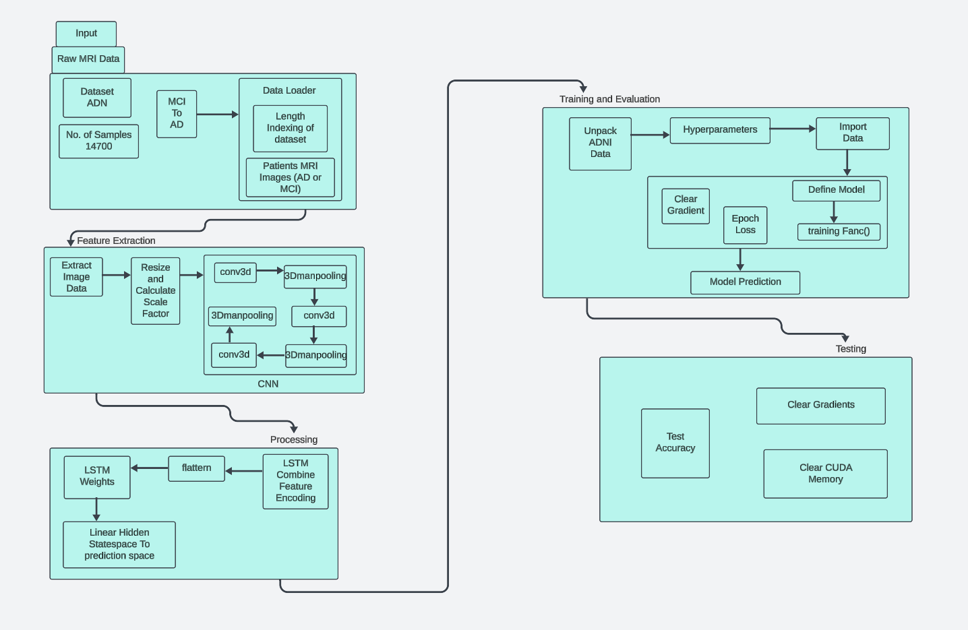
System Architecture

Slide 7
System Architecture
This system architecture diagram illustrates a process for Alzheimer's Disease diagnosis using deep learning. It begins with inputting raw MRI data, which undergoes feature extraction using a 3D convolutional neural network (CNN).
The extracted features are processed by an LSTM (Long Short-Term Memory) network to make predictions. Training and evaluation involve adjusting hyperparameters and defining the model.
The trained model is then tested for accuracy. Finally, the process includes testing and optimizing the model, clearing gradients, and managing CUDA memory.

Slide 8
Datasets
Huggingface.co
https://huggingface.co/datasets/Falah/Alzheimer_MRI
It discusses the different classes of Alzheimer’s disease and provides information on how to download and use the dataset. The dataset contains 6,400 images, with labels indicating the severity of Alzheimer’s disease.​
This dataset focuses on the classification of Alzheimer's disease based on MRI scans. The dataset consists of brain MRI images labeled into four categories:​
'0': Mild_Demented​
'1': Moderate_Demented​
'2': Non_Demented​
'3': Very_Mild_Demented​

Slide 9
Literature Survey
https://docs.google.com/spreadsheets/d/1h88fofBdt7ulPmumsoEF6eZ4gotj3XamKbaNAe_3dFY/edit?gid=0#gid=0
The integration of Convolutional Neural Networks (CNNs) and Long Short-Term Memory (LSTM) networks proves effective in analyzing brain imaging data. CNNs capture structural features in the data, while LSTMs provide temporal sequence analysis, refining diagnostic tools and improving accuracy. Additionally, Generative Adversarial Networks (GANs) generate synthetic data to better train machine-based algorithms and enhance predictive usefulness in longitudinal studies of individuals with Dementia or Alzheimer's Disease. This combined approach can contribute to more precise and accurate diagnoses of dementia and its neurodegenerative forms. I am particularly interested in exploring how the complementary nature of CNN and LSTM can provide more informative accounts of the changes to cognition resulting from Alzheimer's disease.

Slide 10
Limitations
Models may not consistently perform well across different populations and with various imaging technologies.
Deep learning models may lack transparency, making it difficult for clinicians to adopt them for clinical use.
Incomplete or inconsistent follow-up data can affect the analysis of disease progression.
Training and running complex models require significant computational resources.
Models may perform well on training data but struggle with new, unseen cases.
There are privacy and data security risks associated with handling sensitive medical data.
The real-world use of deep learning models may face a lengthy regulatory approval and integration process.

Slide 11
References
https://ieeexplore.ieee.org/abstract/document/9521165?casa_token=8lyvdGTqEPUAAAAA:hvcmIjM_dEdgaLn1C_hcHWkhfbPwS783k29-Cqf7dts7UWJF-b5ngikgbthXfg4ZvWFIT-PsNA
https://onlinelibrary.wiley.com/doi/full/10.1155/2008/403896
https://ieeexplore.ieee.org/abstract/document/8737996
https://ieeexplore.ieee.org/abstract/document/8888197?casa_token=bwNZCA6RAUgAAAAA:UghnjruUU_7acMDSIEXLGnt5EZdMsvKbZKK5OYyFjziVuWUfgFhxOQLcSMIbgz3fEN_y7BMcog
https://www.ncbi.nlm.nih.gov/pmc/articles/PMC8249997/

